Slide 1
Quick Start Kafka
A Hitchhikers Guide to Kafka

Slide 2
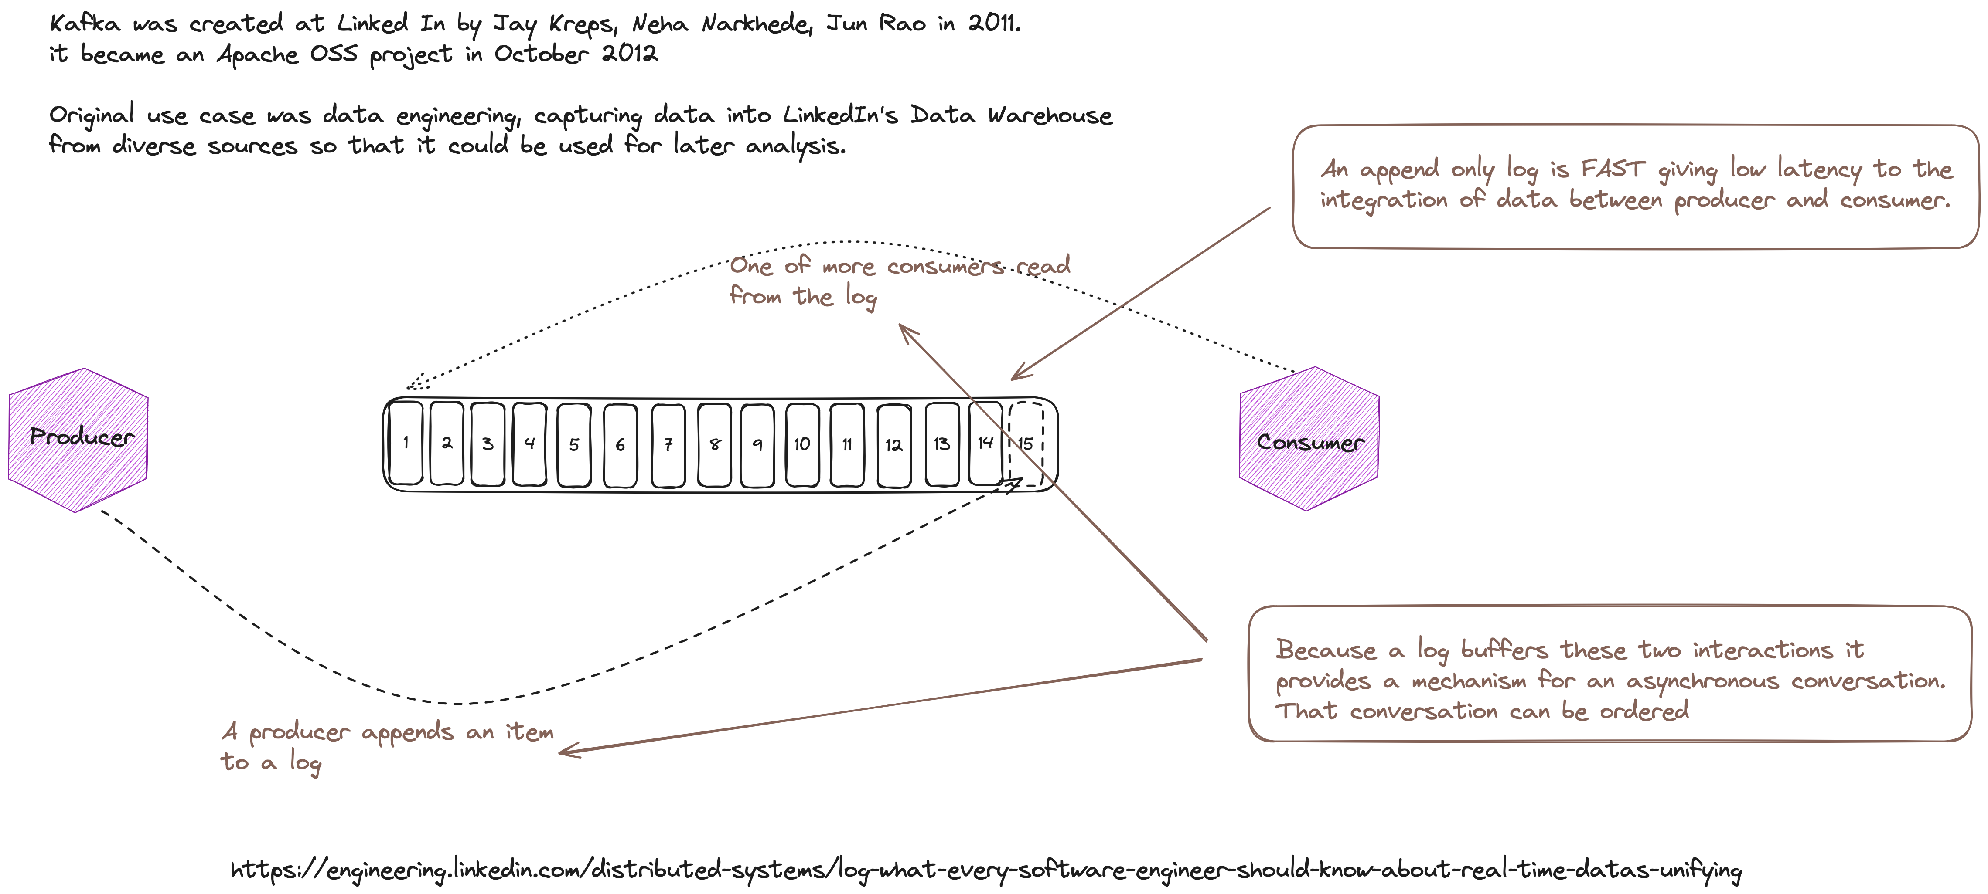

Slide 3
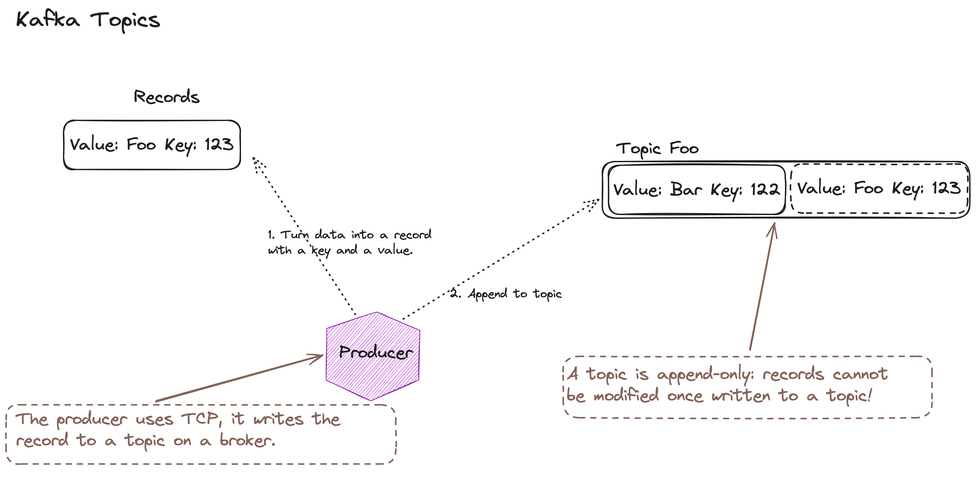

Slide 4
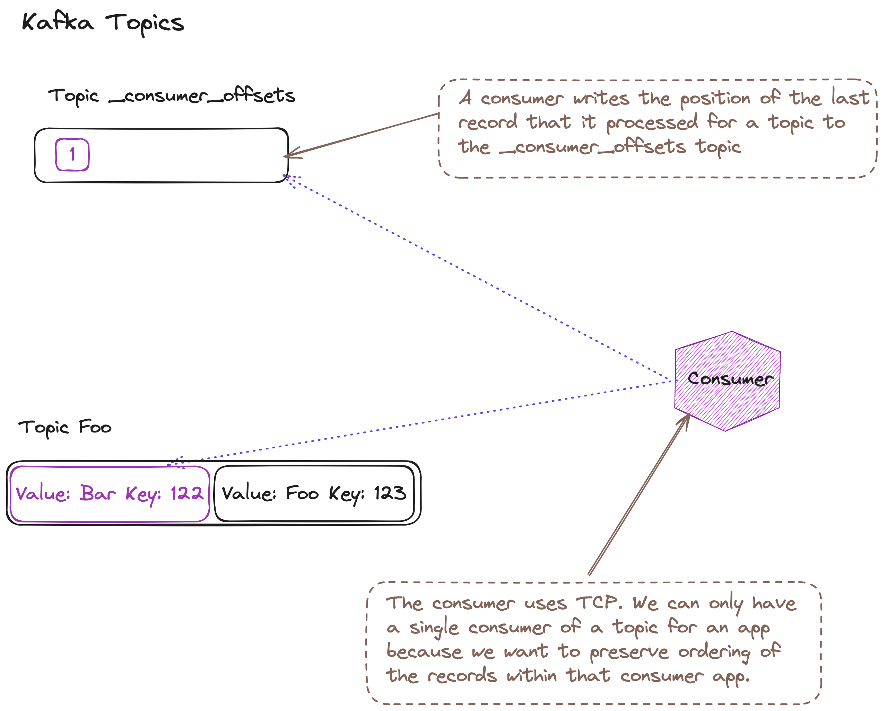

Slide 5
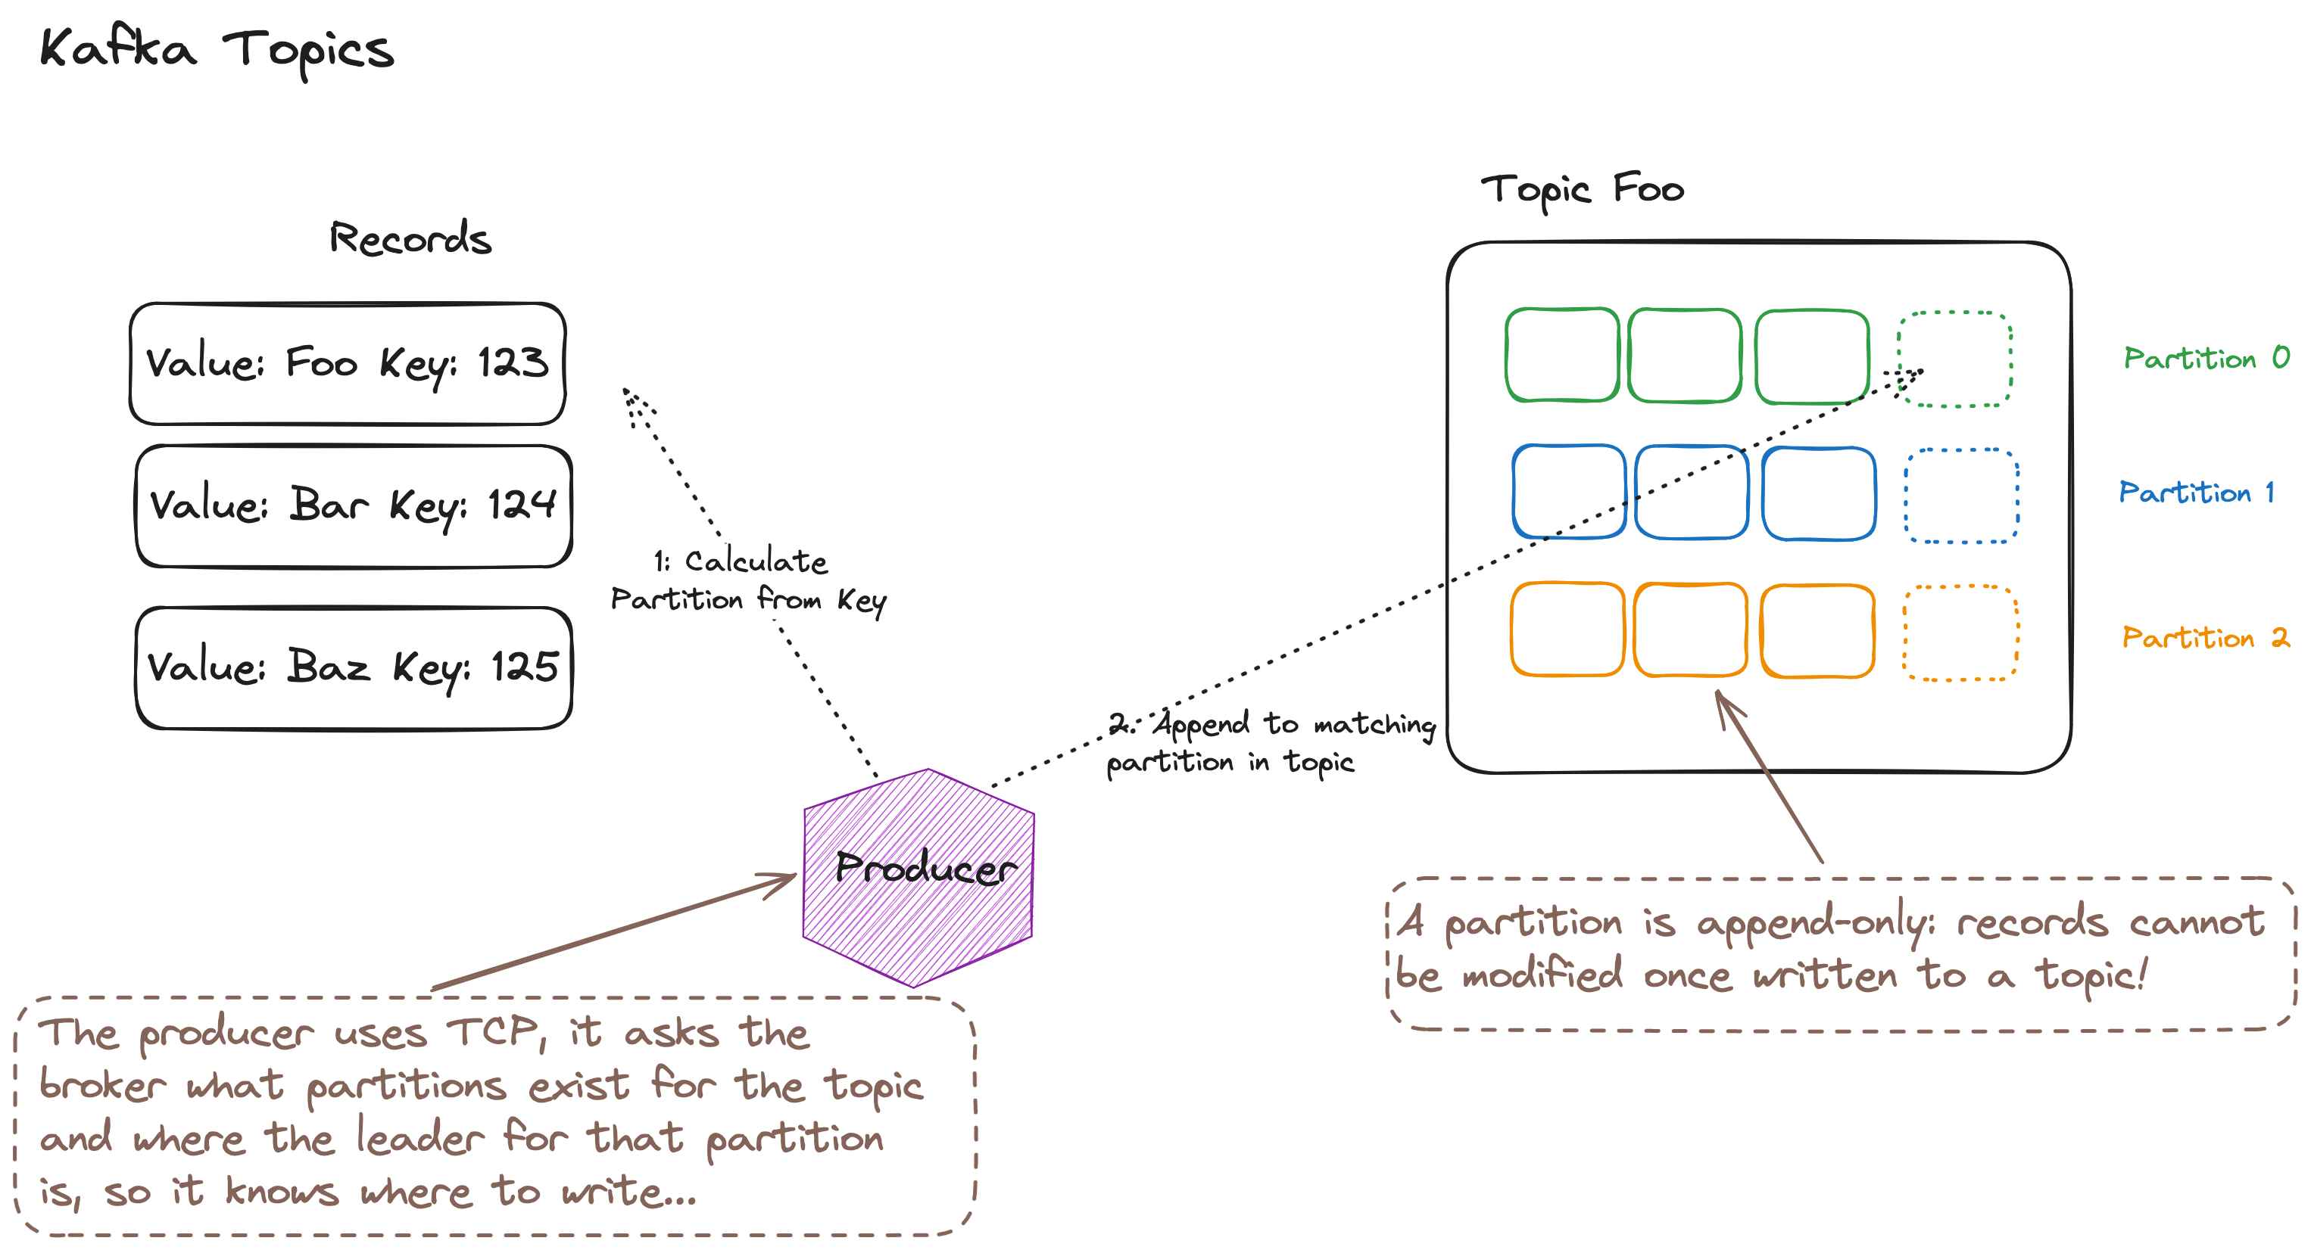

Slide 6
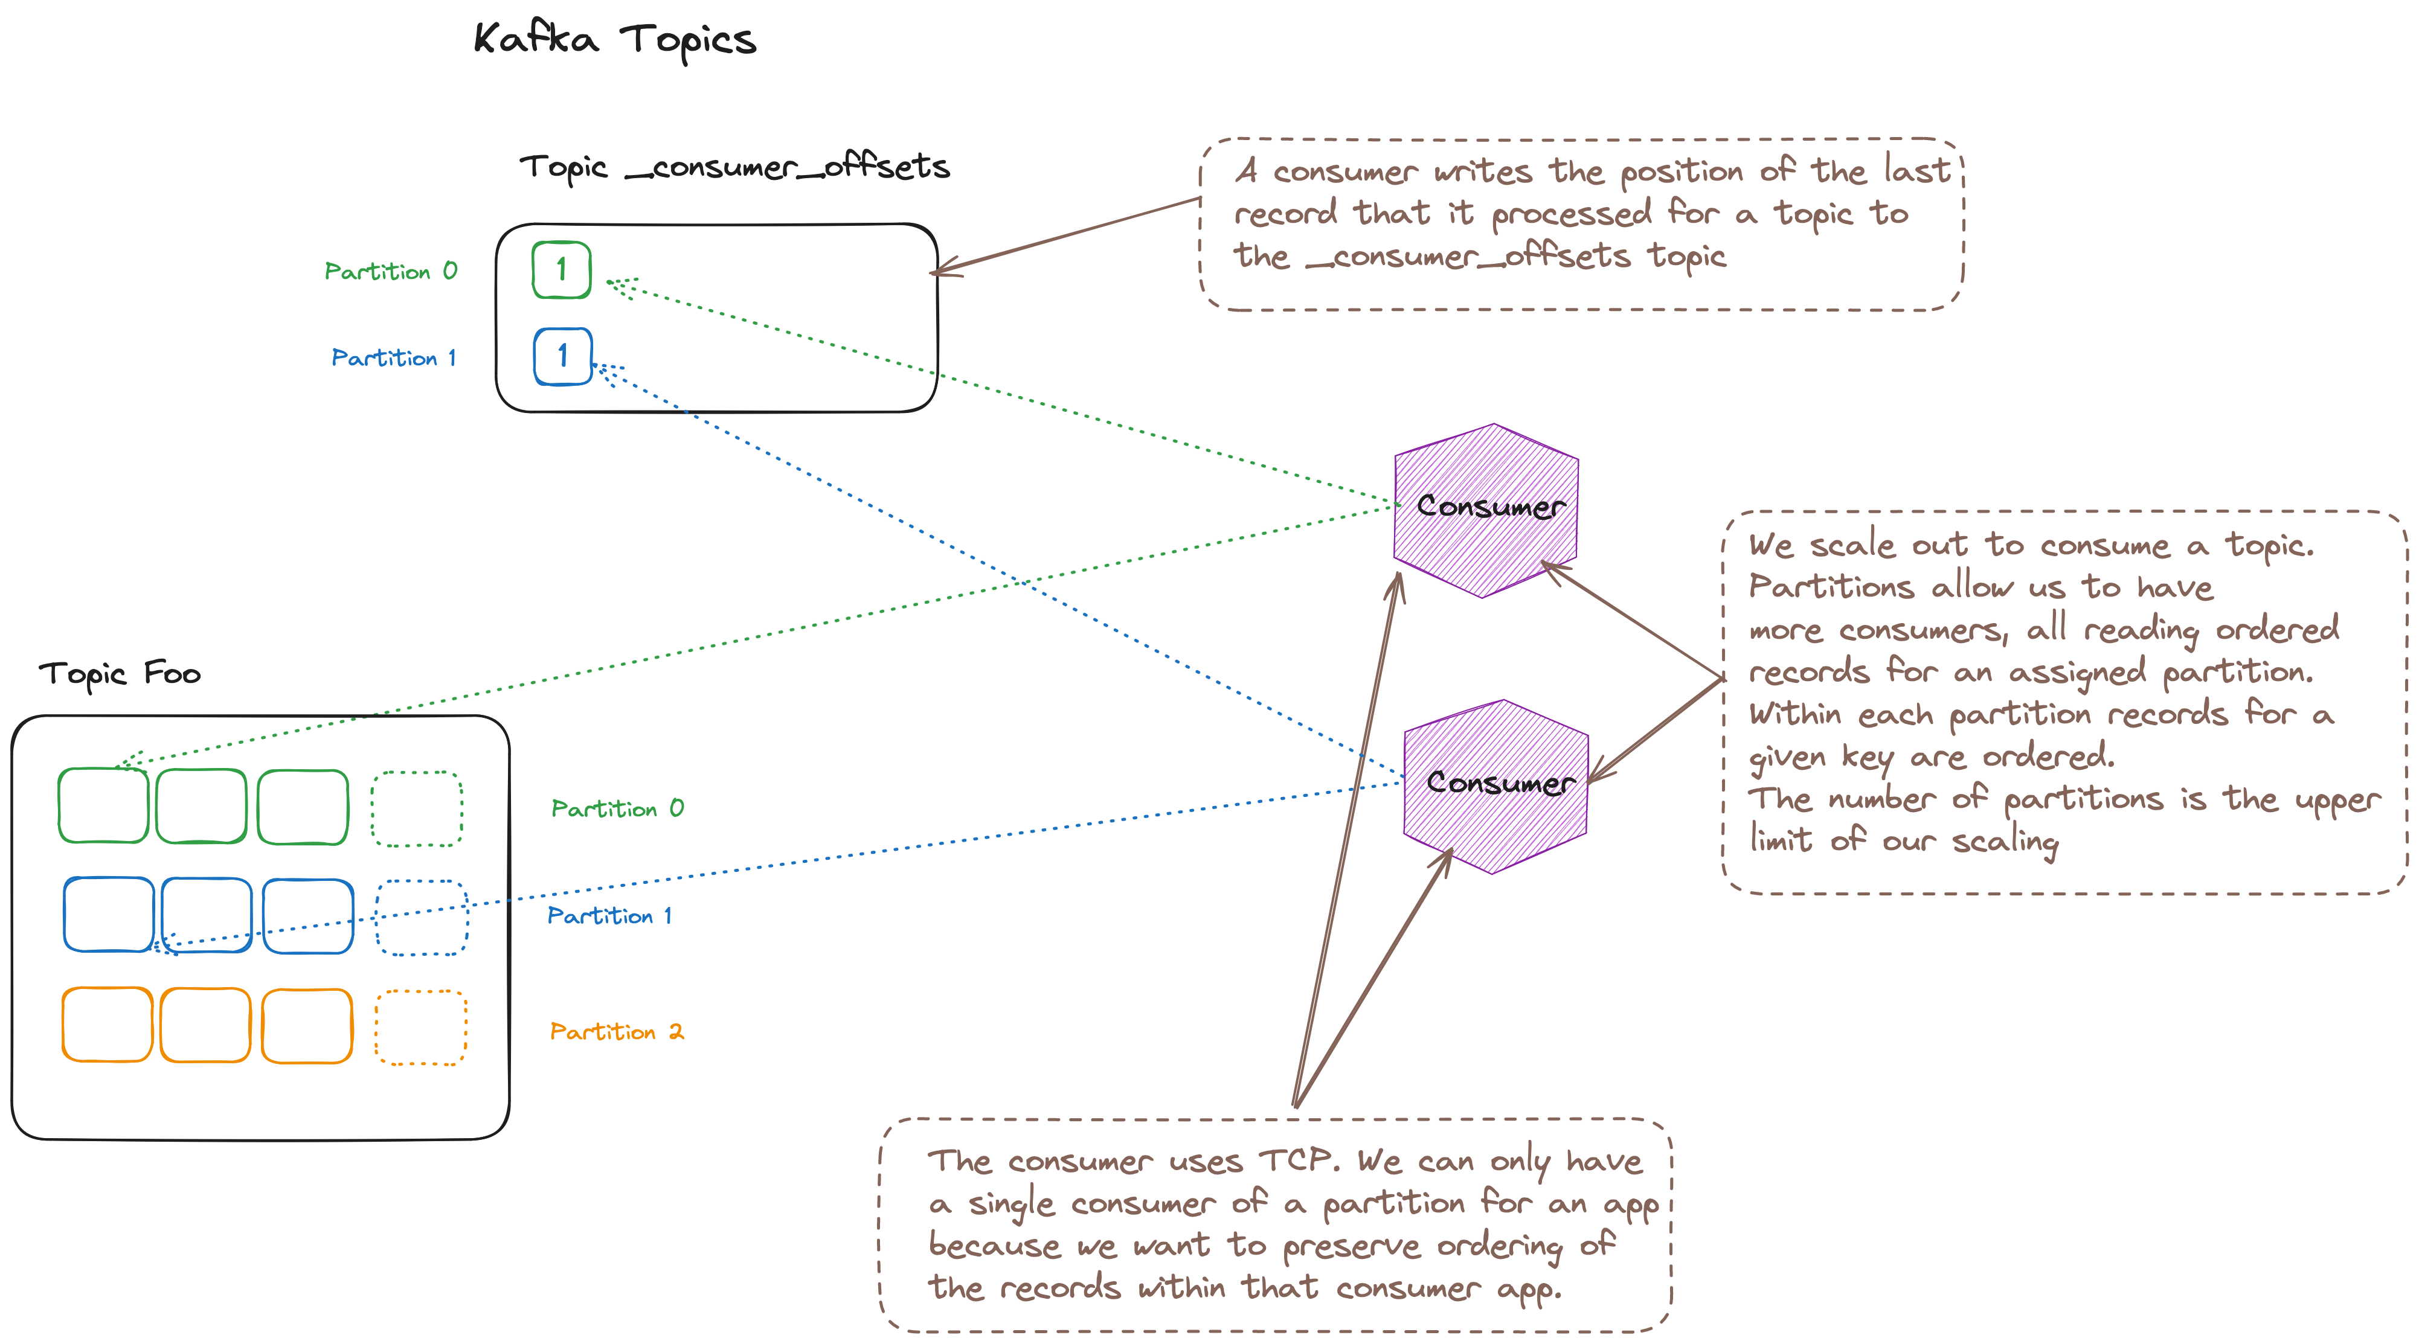

Slide 7
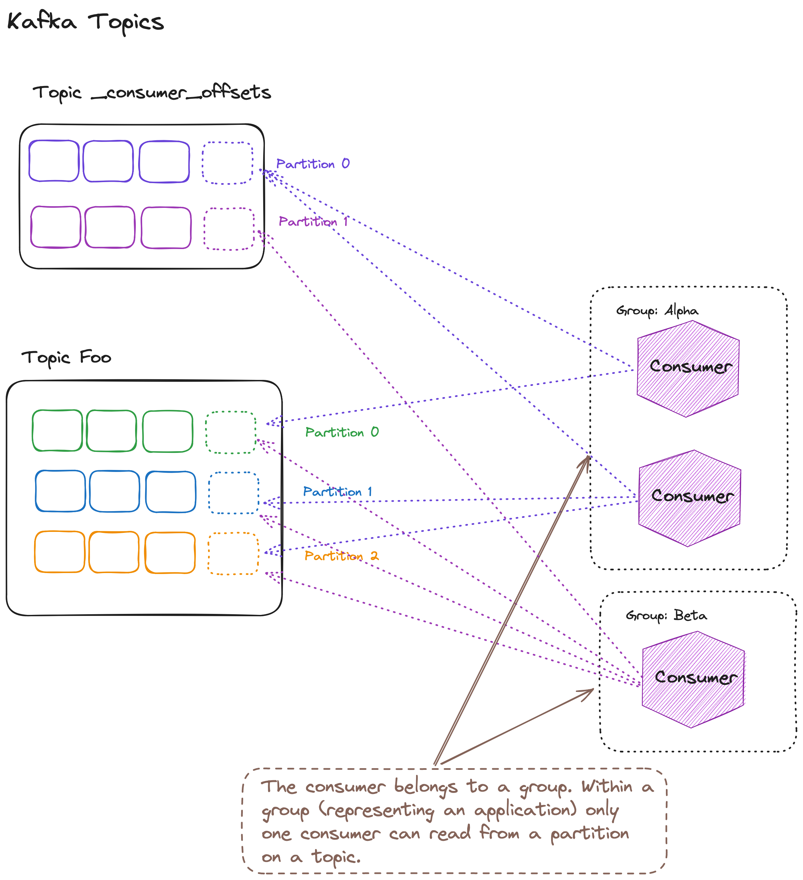

Slide 8
EnableAutoCommit = true
AutCommitIntervalMs = n milliseconds
Your consumer want to commit an offset to Kafka
EnableAutoCommit = true
AutCommitIntervalMs = n milliseconds
Yes
Yes
EnableAutoOffsetStore = false
Call StoreOffset to commit offset when processed
Do you want to commit at an time interval or in batches?
Yes
Are you alright to commit read offsets, that may not have been processed?
No
Do you want to commit at an time interval or in batches?
No
No
Monitor batch count in your code
Call Commit() when you want to commit offsets
Monitor batch count in your code
Call Commit() with specific offsets when you want to commit offsets

Slide 9
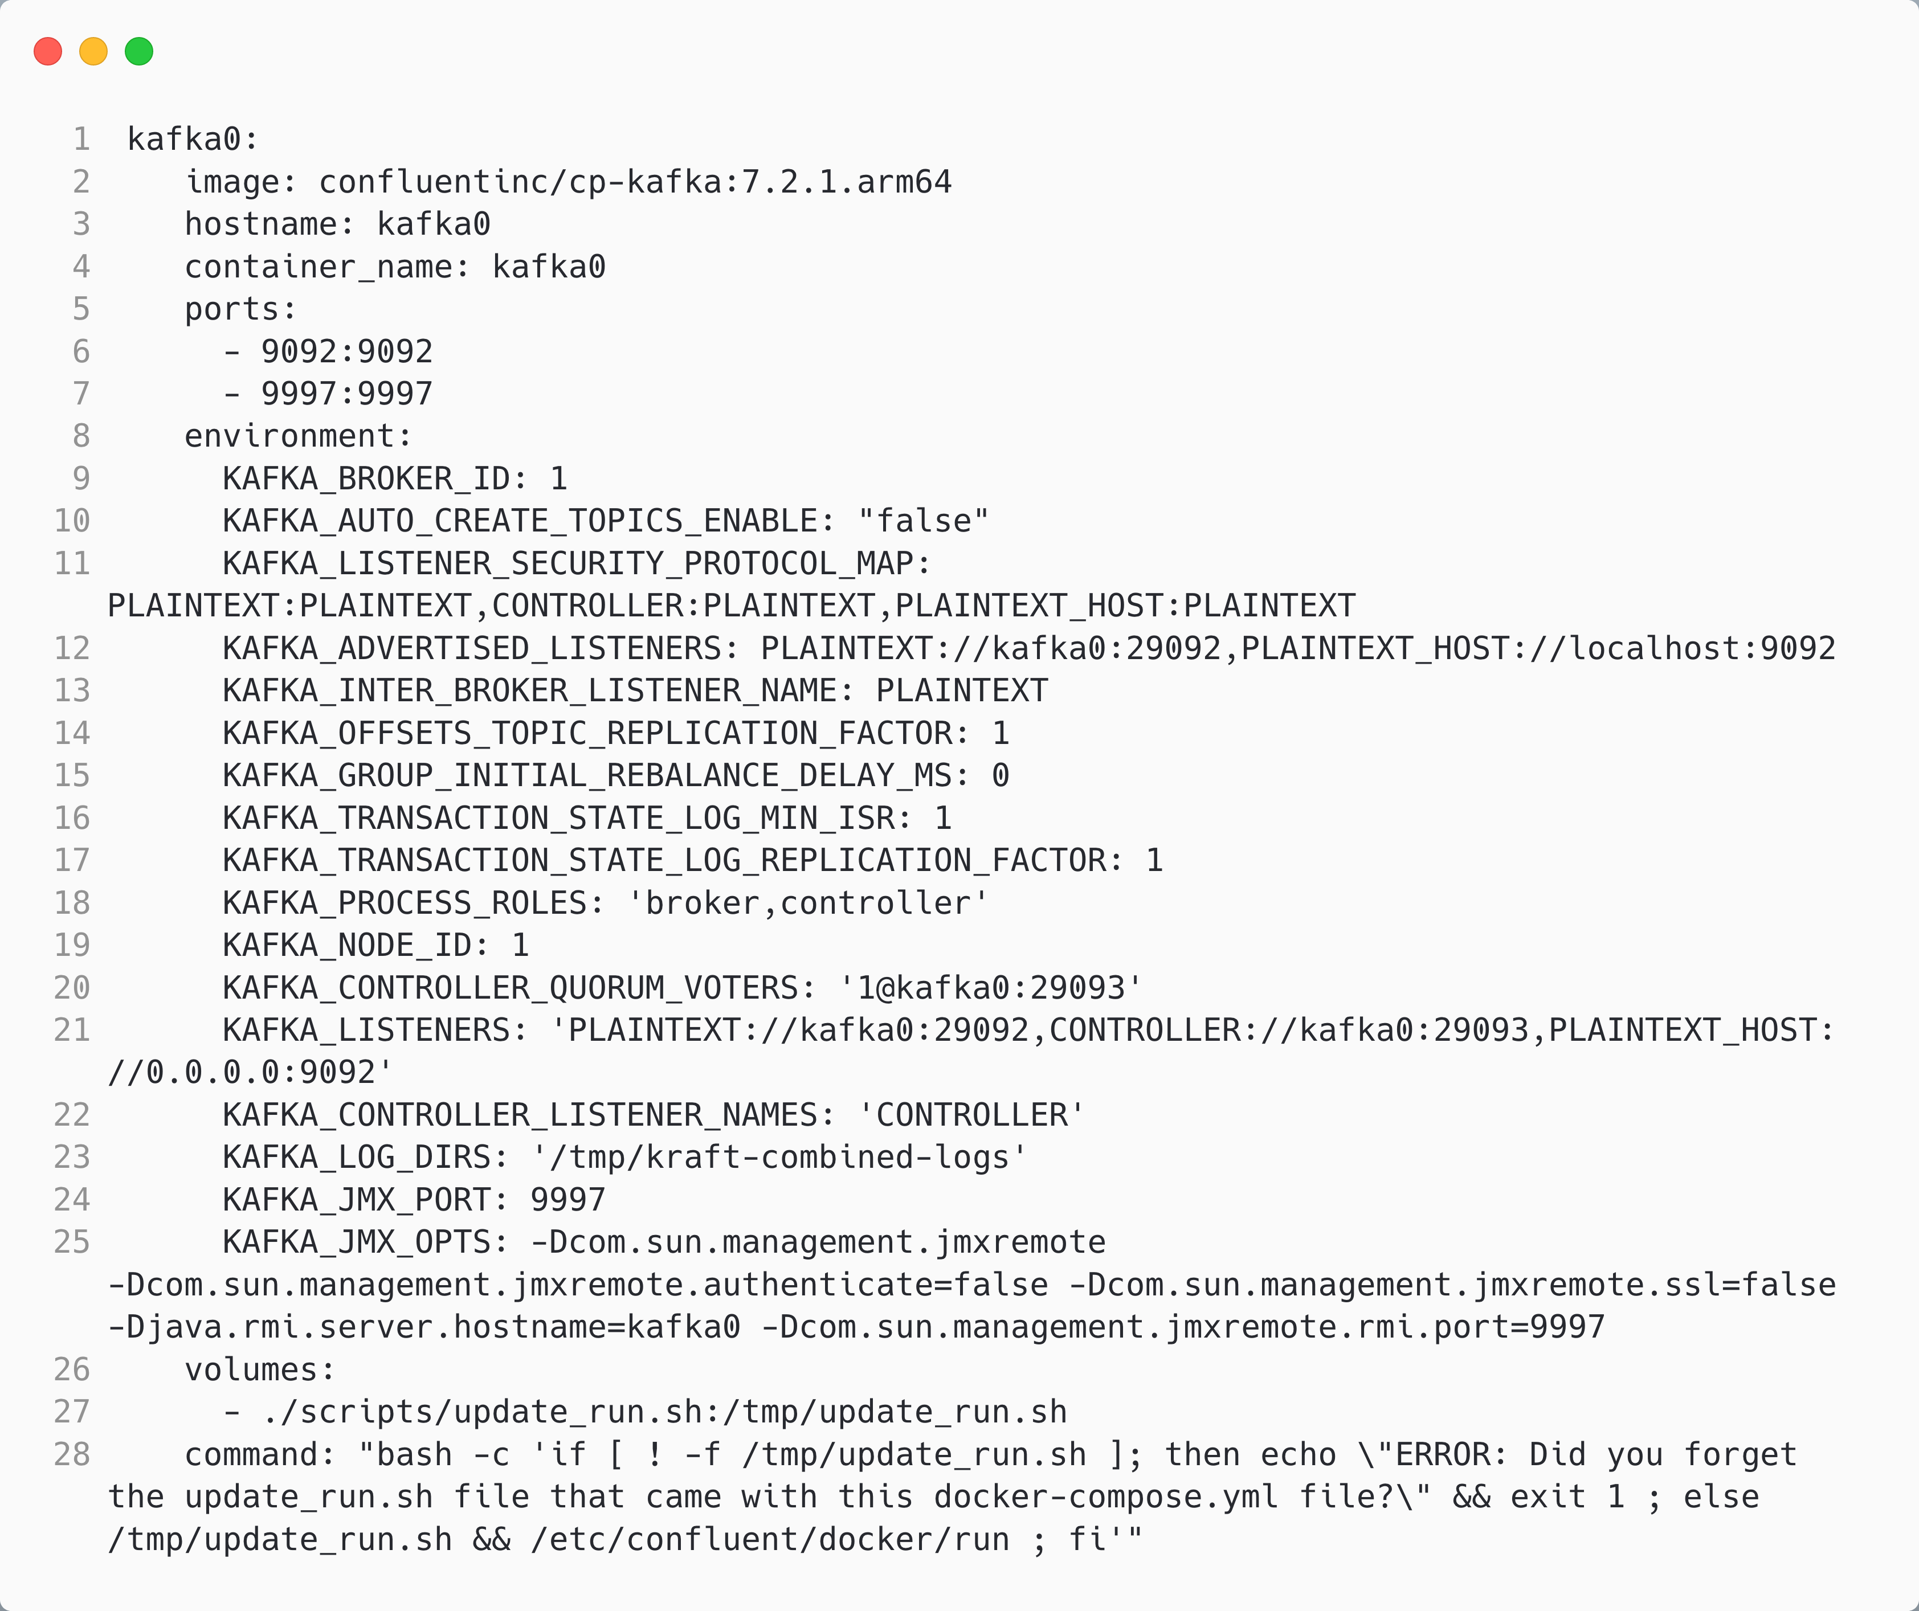
Running Kafka
If a topic does not exist when a producer writes, what should Kafka do?
The advertised listeners are the endpoints that clients should use to communicate with broker
The roles that this node plays
The listeners are the endpoints that the broker listens on
We need to run a script to run without zookeeper

